Slide 1
热物（第十、十一周）
黑体辐射
Debye固体
BEC

Slide 2
热物（第十、十一周）
黑体辐射
Debye固体
BEC

Slide 3
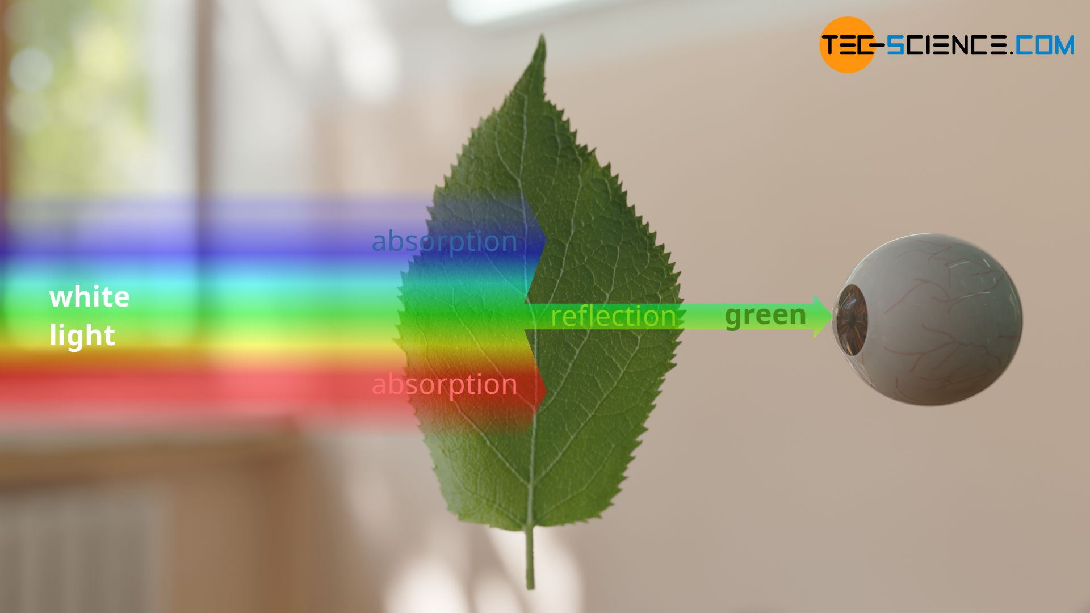
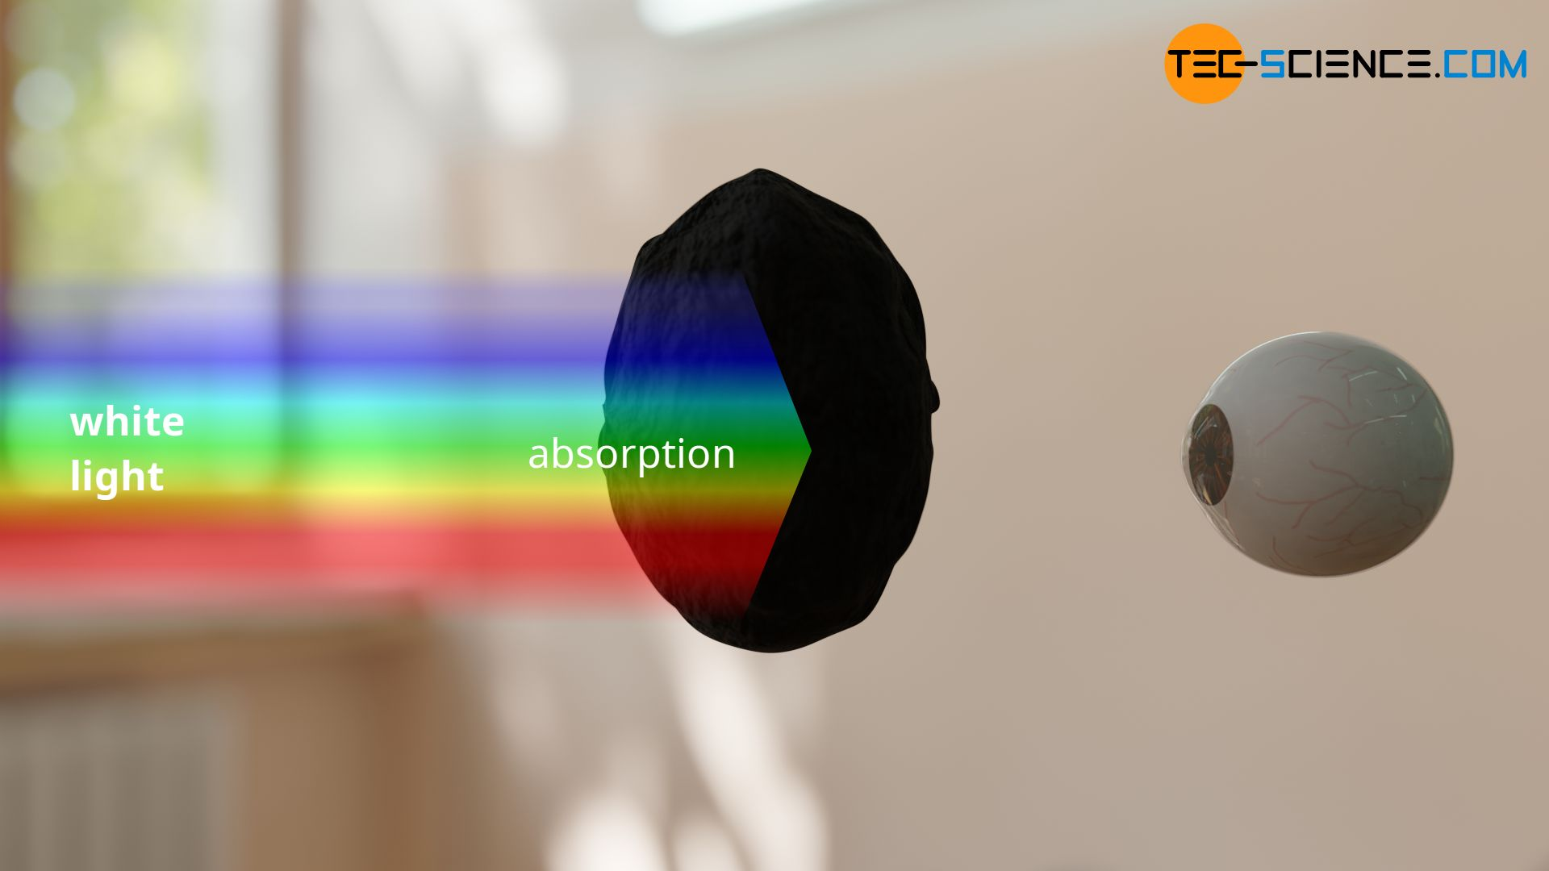

Slide 4
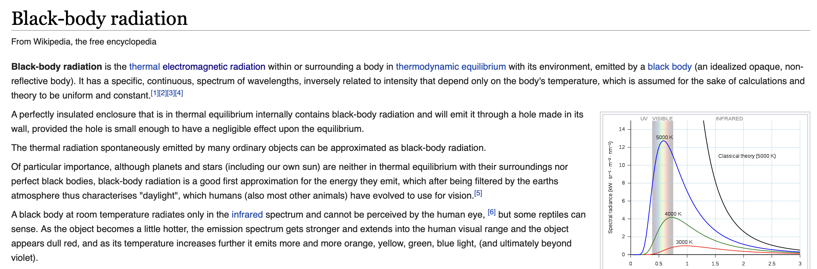
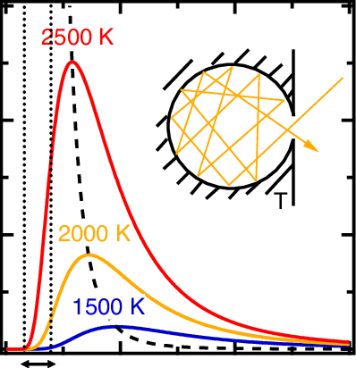
Black-body radiation has a characteristic, continuous frequency spectrum
that depends only on the body's temperature

Slide 5
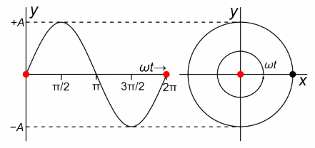

约束在方盒子中的电磁场（经典）
约束在腔中的辐射场相当于一大群简偕振子组成的力学体系
$$τ$$

Slide 6
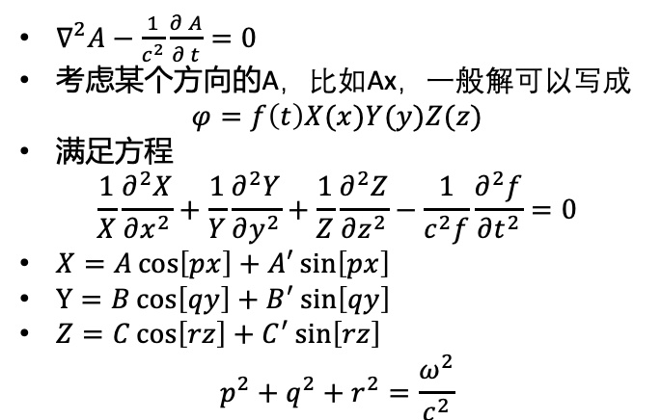
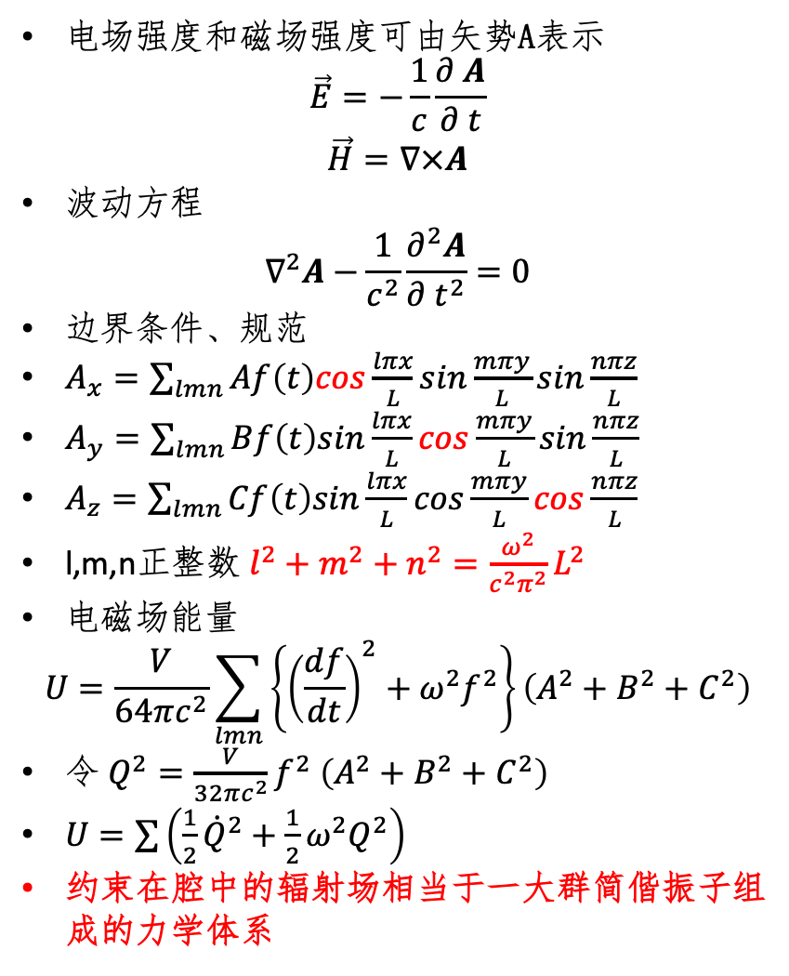

约束在方盒子中的电磁场（经典）
电场强度和磁场强度可由矢势A表示
$$\vec{E}=−\frac{1}{c}\frac{∂ A}{∂ t}$$
$$\vec{H}=∇×A$$
波动方程
$$∇^{2}A−\frac{1}{c^{2}}\frac{∂^{2}A}{∂ t^{2}}=0$$
边界条件、规范
$A_{x}=\sum_{lmn}{Af\left(t\right)cos\frac{lπx}{L}sin\frac{mπy}{L}sin\frac{nπz}{L}}$
$A_{y}=\sum_{lmn}{Bf\left(t\right)sin\frac{lπx}{L}cos\frac{mπy}{L}sin\frac{nπz}{L}}$
$A_{z}=\sum_{lmn}{Cf\left(t\right)sin\frac{lπx}{L}cos\frac{mπy}{L}cos\frac{nπz}{L}}$
l,m,n正整数 $l^{2}+m^{2}+n^{2}=\frac{ω^{2}}{c^{2}π^{2}}L^{2}$
电磁场能量
$$U=\frac{V}{64πc^{2}}\sum_{lmn}{\left\{{\left(\frac{df}{dt}\right)}^{2}+ω^{2}f^{2}\right\}}\left(A^{2}+B^{2}+C^{2}\right)$$
令 $Q^{2}=\frac{V}{32πc^{2}}f^{2}$ $\left(A^{2}+B^{2}+C^{2}\right)$
$U=\sum{\left(\frac{1}{2}{\dot{Q}}^{2}+\frac{1}{2}ω^{2}Q^{2}\right)}$
约束在腔中的辐射场相当于一大群简偕振子组成的力学体系
$$τ$$
$∇∙A=0$

Slide 7

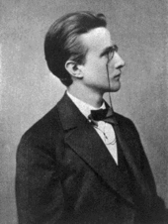
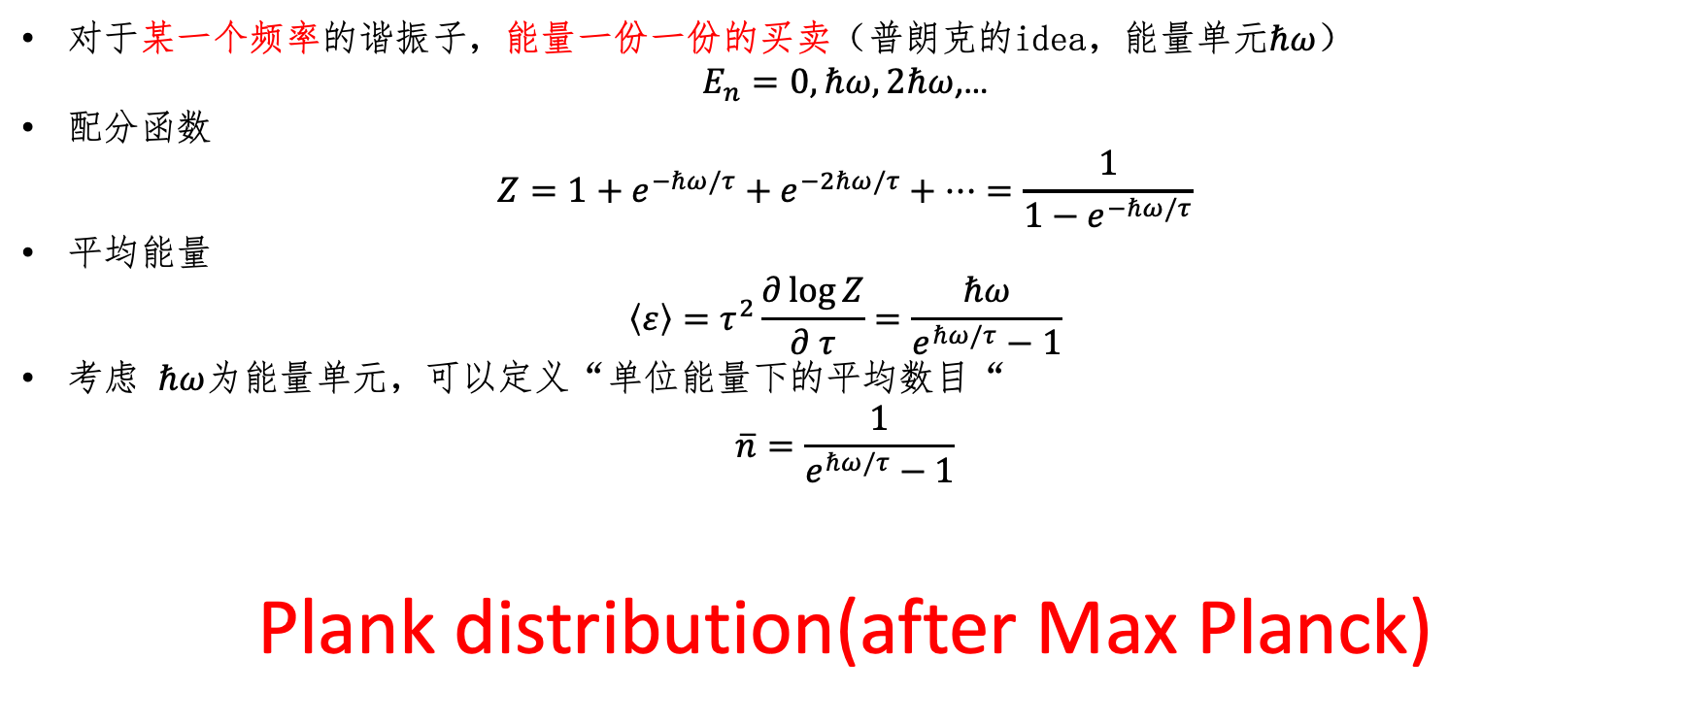
特定频率(每一个谐振子贡献$τ$能量，总能量无穷，紫外灾难，量子力学的诞生)
对于某一个频率的谐振子，能量一份一份的买卖（普朗克的idea，能量单元$ℏω$）
$E_{n}=0,ℏω,2ℏω$,…
配分函数
$$Z=1+e^{−ℏω/τ}+e^{−2ℏω/τ}+…=\frac{1}{1−e^{−ℏω/τ}}$$
平均能量
$$\left\langle ε\right\rangle =τ^{2}\frac{∂\log{Z}}{∂ τ}=\frac{ℏω}{e^{ℏω/τ}−1}$$
考虑 $ℏω$为能量单元，可以定义“单位能量下的平均数目“
$$\overline{n}=\frac{1}{e^{ℏω/τ}−1}$$
Plank distribution(after Max Planck)

Slide 8
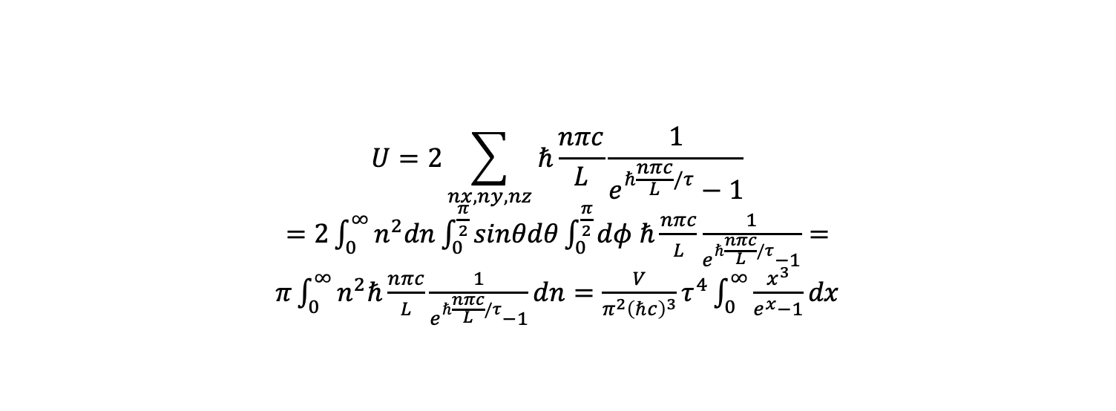
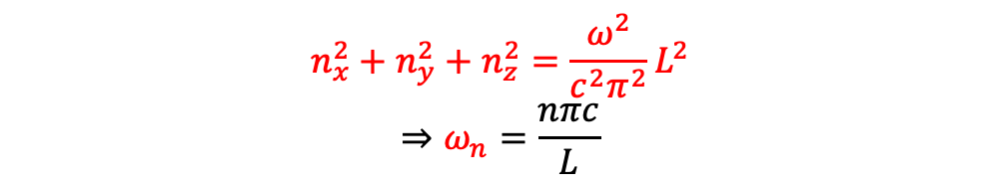
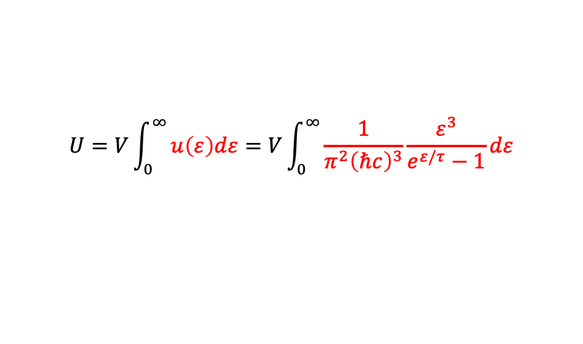

所有频率、Modes求和
$$n_{x}^{2}+n_{y}^{2}+n_{z}^{2}=\frac{ω^{2}}{c^{2}π^{2}}L^{2}$$
$$⇒ω_{n}=\frac{nπc}{L}$$
$$U=2\sum_{nx,ny,nz}{ℏ\frac{nπc}{L}\frac{1}{e^{ℏ\frac{nπc}{L}/τ}−1}}$$
$=2\int_{0}^{∞}{n^{2}dn\int_{0}^{\frac{π}{2}}{sinθdθ\int_{0}^{\frac{π}{2}}{dφ}}}$ $ℏ\frac{nπc}{L}\frac{1}{e^{ℏ\frac{nπc}{L}/τ}−1}=π\int_{0}^{∞}{n^{2}ℏ\frac{nπc}{L}\frac{1}{e^{ℏ\frac{nπc}{L}/τ}−1}dn=\frac{V}{π^{2}{\left(ℏc\right)}^{3}}τ^{4}\int_{0}^{∞}{\frac{x^{3}}{e^{x}−1}dx}}$
$$x=\frac{ε}{τ}$$
$$U=V\int_{0}^{∞}{u\left(ε\right)dε=V\int_{0}^{∞}{\frac{1}{π^{2}{\left(ℏc\right)}^{3}}\frac{ε^{3}}{e^{ε/τ}−1}dε}}$$
普朗克公式

Slide 9
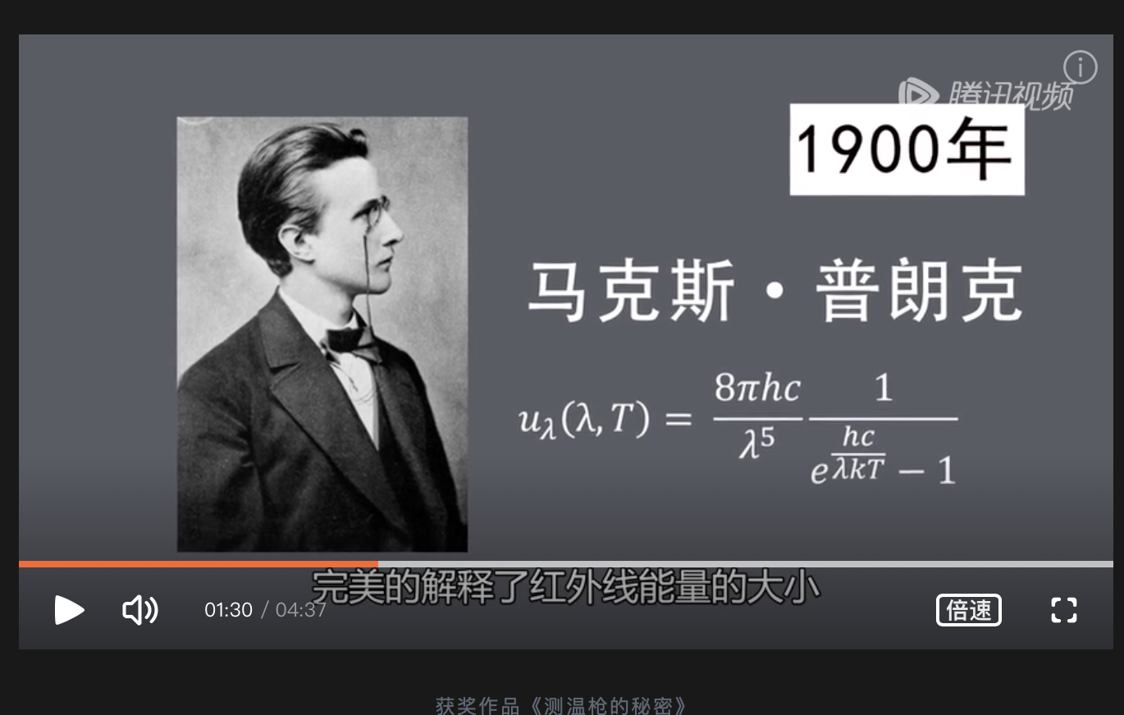
所有频率、Modes求和
$$n_{x}^{2}+n_{y}^{2}+n_{z}^{2}=\frac{ω^{2}}{c^{2}π^{2}}L^{2}$$
$$⇒ω_{n}=\frac{nπc}{L}$$
$$U=2\sum_{nx,ny,nz}{ℏ\frac{nπc}{L}\frac{1}{e^{ℏ\frac{nπc}{L}/τ}−1}}$$
$=2\int_{0}^{∞}{n^{2}dn\int_{0}^{\frac{π}{2}}{sinθdθ\int_{0}^{\frac{π}{2}}{dφ}}}$ $ℏ\frac{nπc}{L}\frac{1}{e^{ℏ\frac{nπc}{L}/τ}−1}=π\int_{0}^{∞}{n^{2}ℏ\frac{nπc}{L}\frac{1}{e^{ℏ\frac{nπc}{L}/τ}−1}dn=\frac{V}{π^{2}{\left(ℏc\right)}^{3}}τ^{4}\int_{0}^{∞}{\frac{x^{3}}{e^{x}−1}dx}}$
$$x=\frac{ε}{τ}$$
$$U=V\int_{0}^{∞}{u\left(ε\right)dε=V\int_{0}^{∞}{\frac{1}{π^{2}{\left(ℏc\right)}^{3}}\frac{ε^{3}}{e^{ε/τ}−1}dε}}$$
普朗克公式

Slide 10
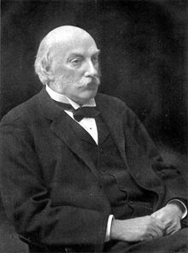
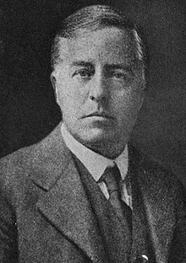
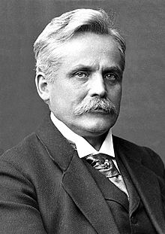
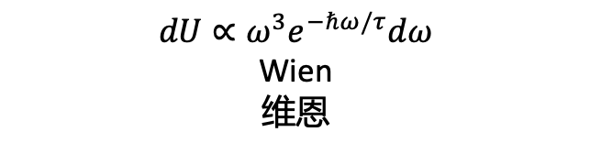

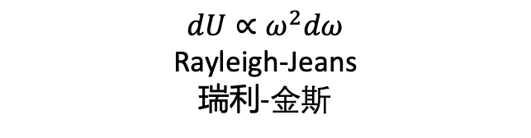
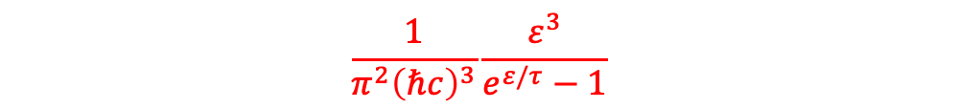



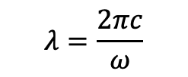


$$λ=\frac{2πc}{ω}$$
$$ε=ℏω$$
$$dU=Vu\left(ε\right)dε$$
$$dU=Vf\left(ω\right)dω$$
$$dU=Vg\left(λ\right)dλ$$
$$\frac{1}{π^{2}{\left(ℏc\right)}^{3}}\frac{ε^{3}}{e^{ε/τ}−1}$$
$$ℏω≪τ$$
$$ℏω≫τ$$
$$dU∝ω^{2}dω$$
Rayleigh-Jeans
瑞利-金斯
$$dU∝ω^{3}e^{−ℏω/τ}dω$$
Wien
维恩

Slide 11
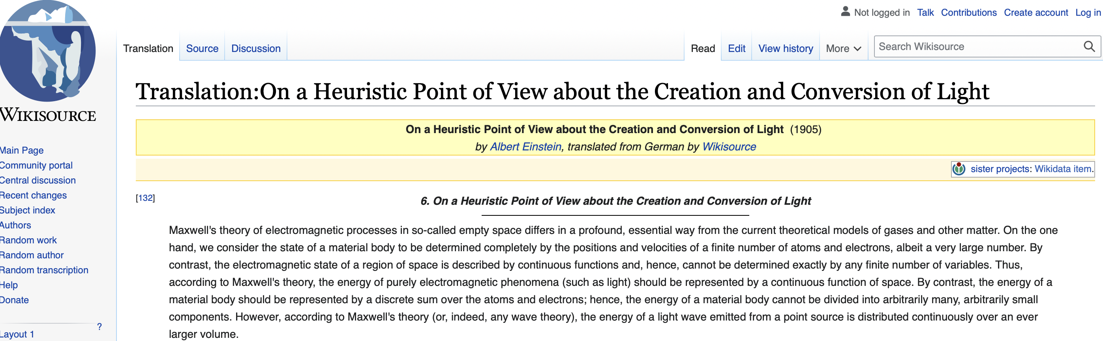
光子
https://en.wikisource.org/wiki/Translation:On_a_Heuristic_Point_of_View_about_the_Creation_and_Conversion_of_Light#cite_note-5

Slide 12
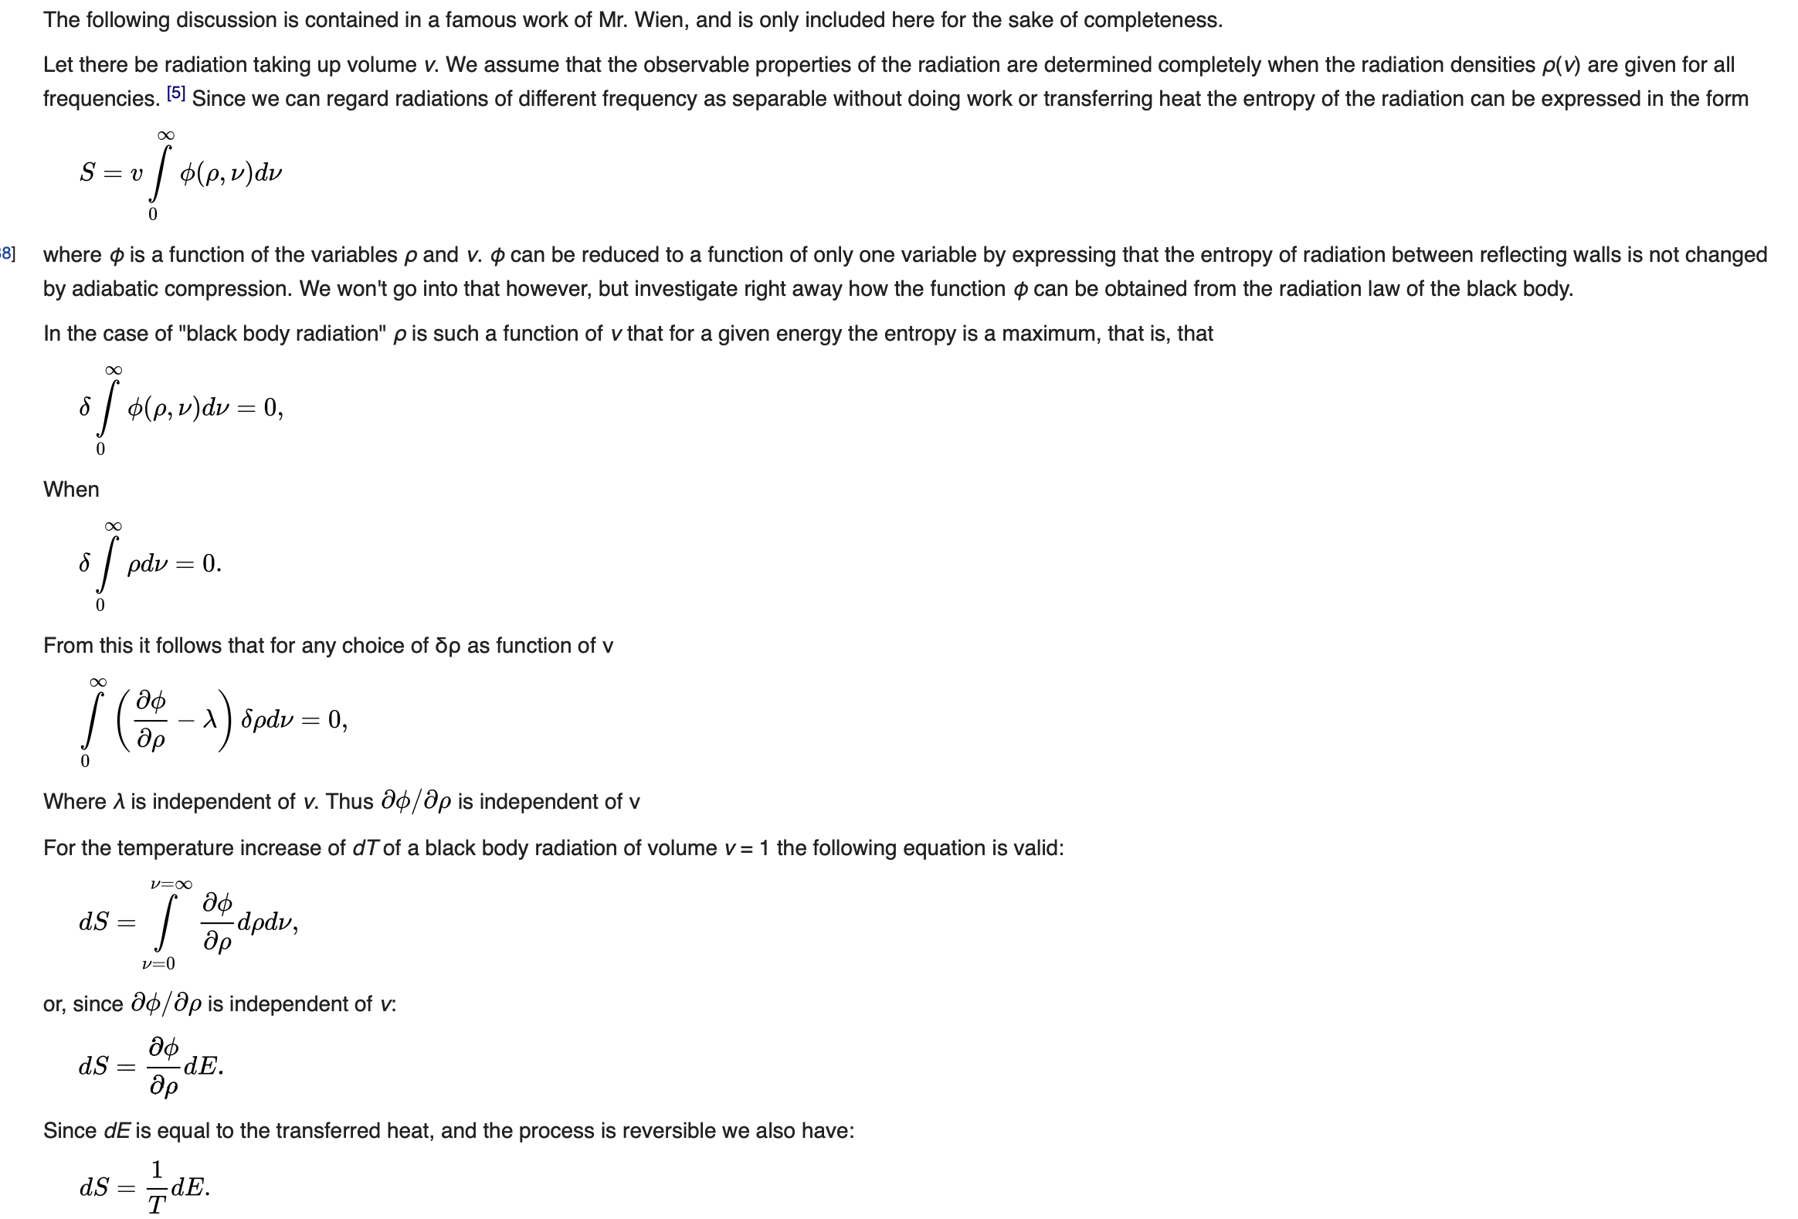
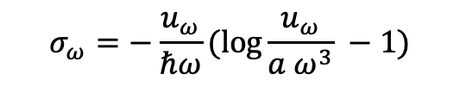
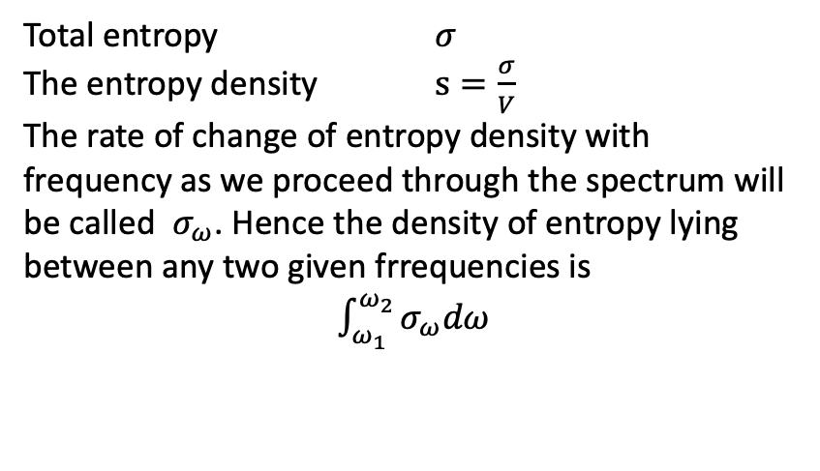

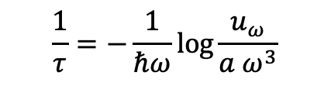
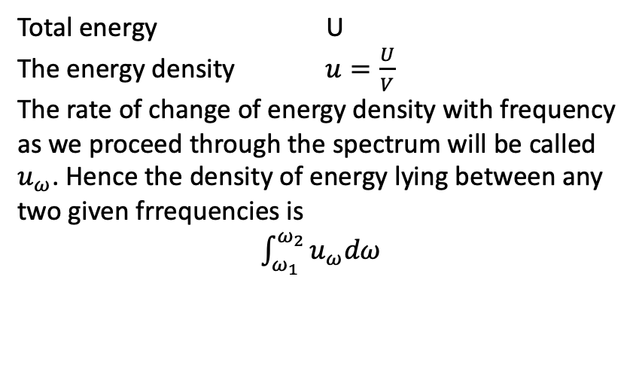
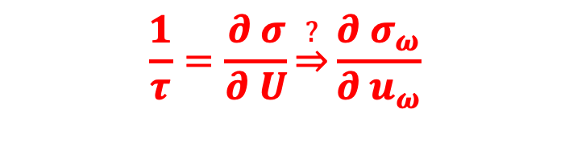
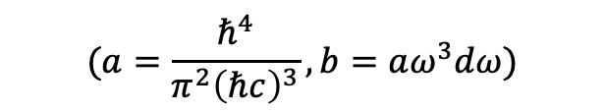
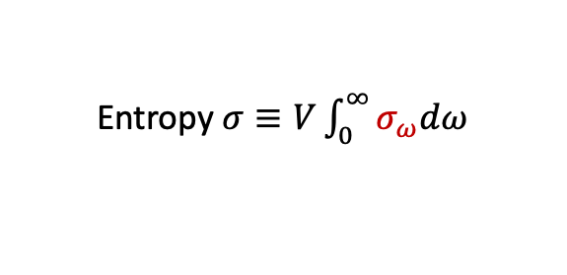
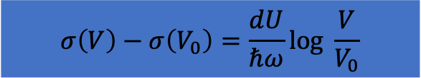
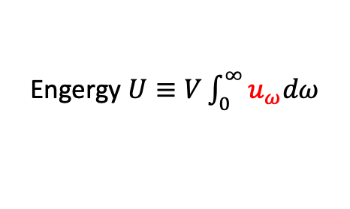
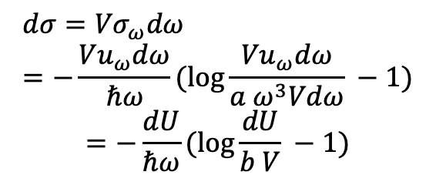
Trying…
Total energy U
The energy density $u=\frac{U}{V}$
The rate of change of energy density with frequency as we proceed through the spectrum will be called $u_{ω}$. Hence the density of energy lying between any two given frrequencies is
$\int_{ω_{1}}^{ω_{2}}{u_{ω}dω}$
Total entropy $σ$
The entropy density $s=\frac{σ}{V}$
The rate of change of entropy density with frequency as we proceed through the spectrum will be called $σ_{ω}$. Hence the density of entropy lying between any two given frrequencies is
$\int_{ω_{1}}^{ω_{2}}{σ_{ω}dω}$
Engergy $U≡V\int_{0}^{∞}{u_{ω}dω}$
When $ℏω≫τ$, $u_{ω}=\frac{ℏ^{4}}{π^{2}{\left(ℏc\right)}^{3}}ω^{3}e^{−ℏω/τ}$
$$\frac{1}{τ}=−\frac{1}{ℏω}\log{\frac{u_{ω}}{a ω^{3}}}$$
Entropy $σ≡V\int_{0}^{∞}{σ_{ω}dω}$
$$(a=\frac{ℏ^{4}}{π^{2}{\left(ℏc\right)}^{3}},b=aω^{3}dω)$$
$$\frac{1}{τ}=\frac{∂ σ}{∂ U}\underset{⇒}{?}\frac{∂ σ_{ω}}{∂ u_{ω}}$$
$$σ_{ω}=−\frac{u_{ω}}{ℏω}(log{\frac{u_{ω}}{a ω^{3}}} −1)$$
we have:
$${dσ=Vσ}_{ω}dω=−\frac{{Vu}_{ω}dω}{ℏω}(\log{\frac{{Vu}_{ω}dω}{a ω^{3}Vdω}} −1)$$
$$=−\frac{dU}{ℏω}(log{\frac{dU}{b V} −1)}$$
$$σ\left(V\right)−σ\left(V_{0}\right)=\frac{dU}{ℏω}log \frac{V}{V_{0}}$$

Slide 13
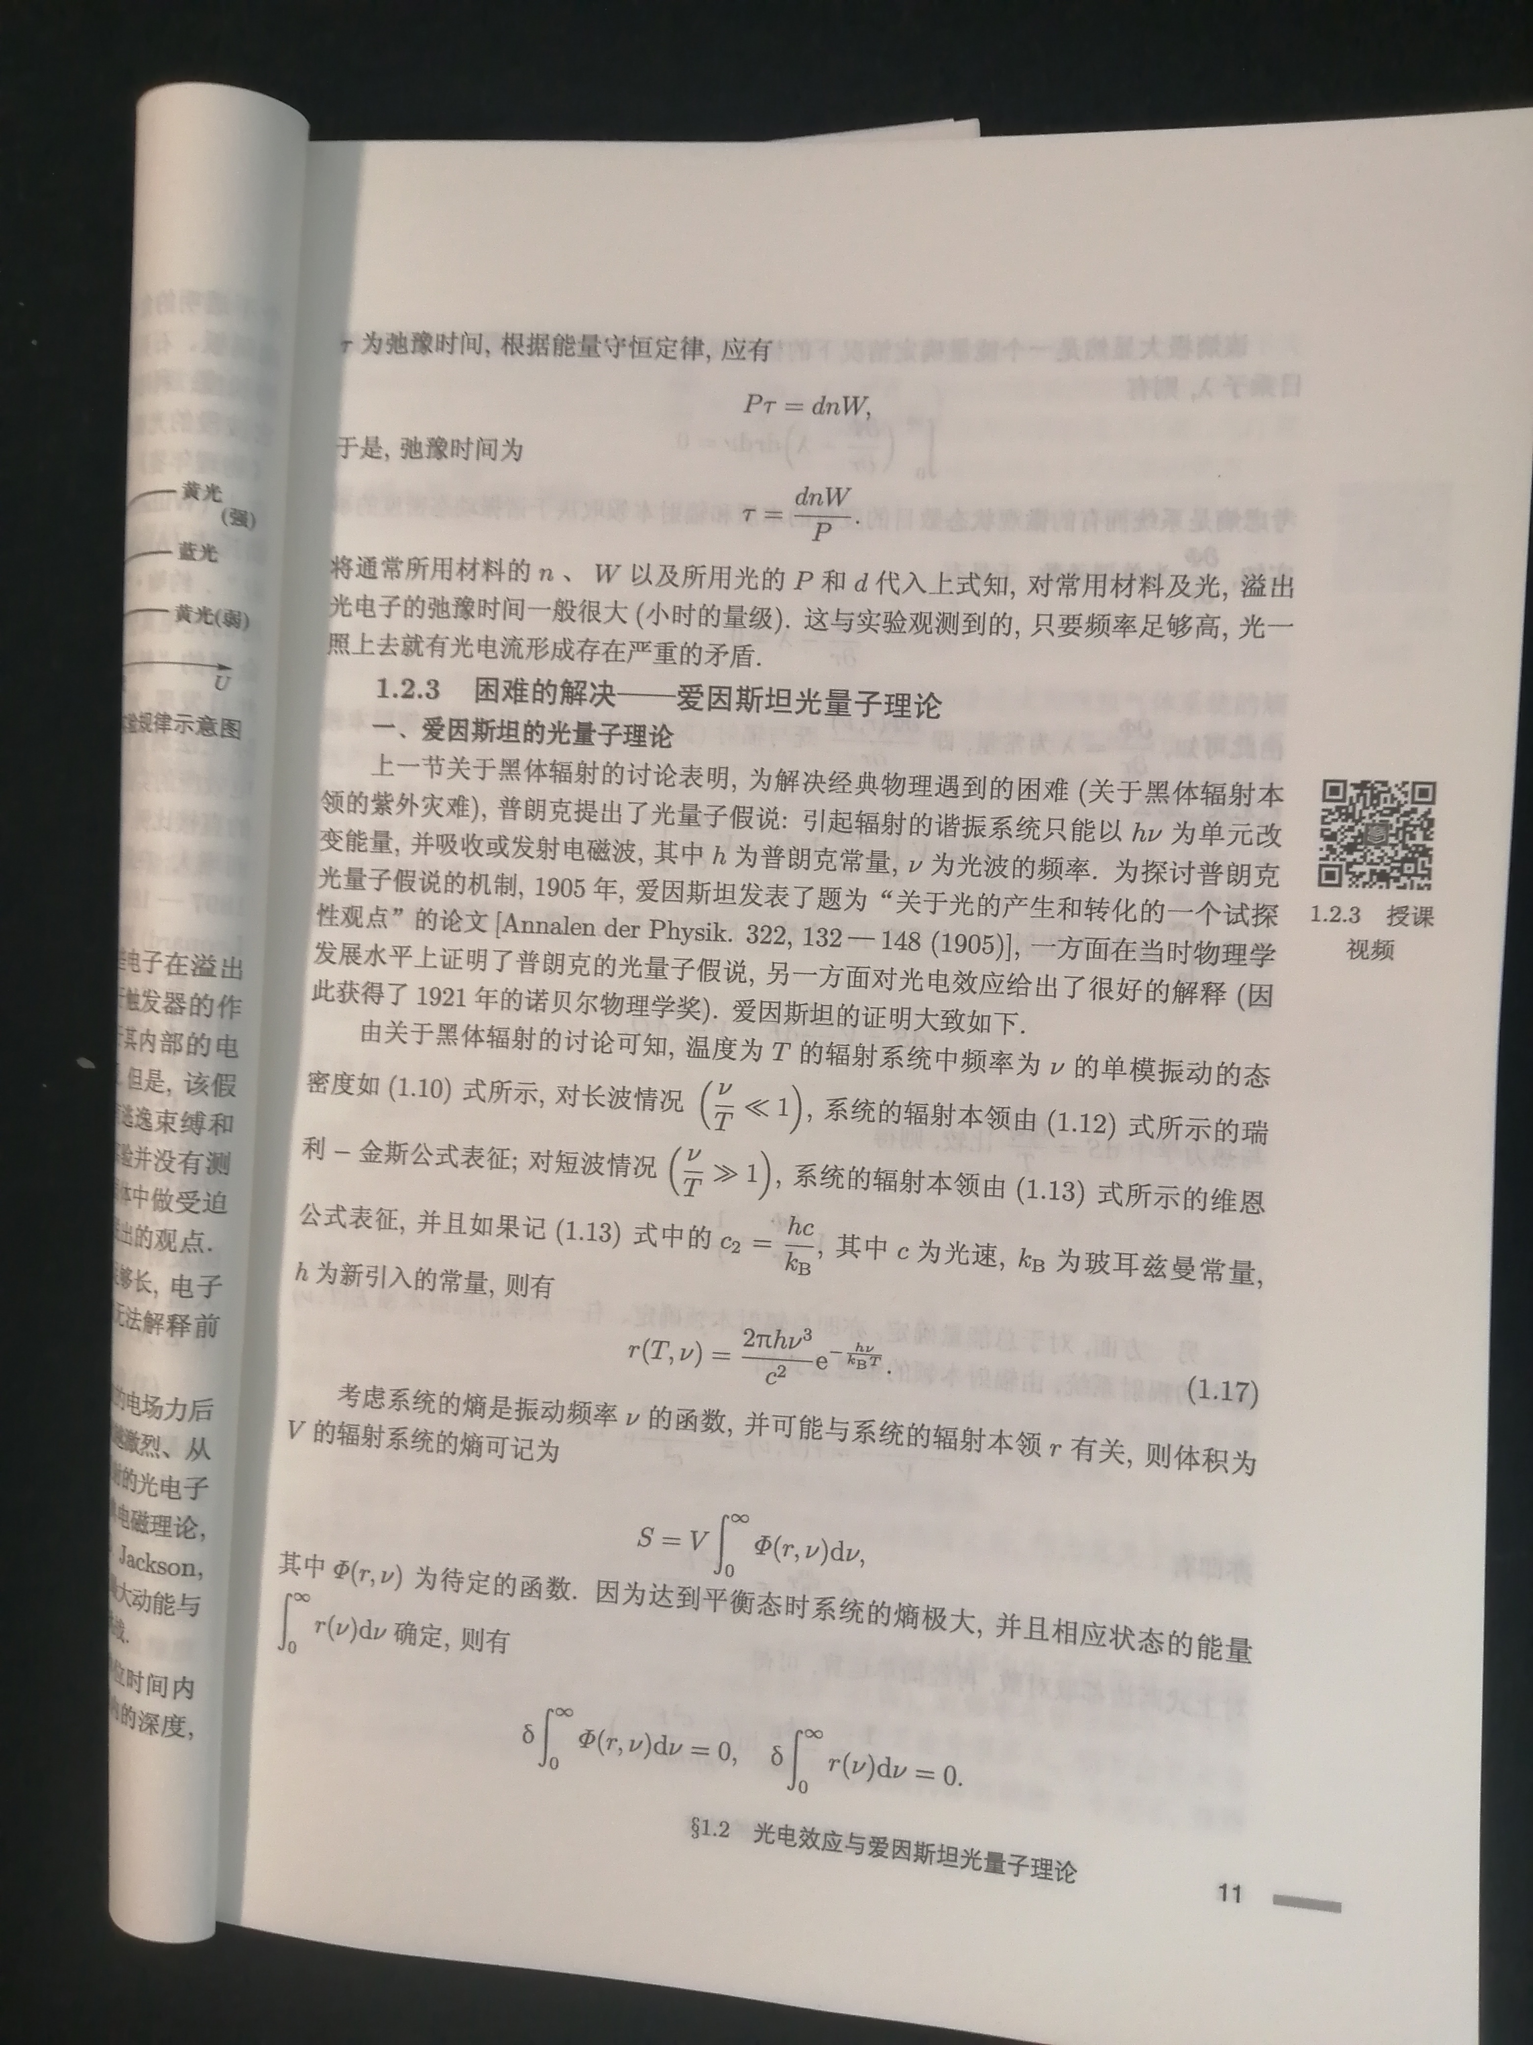
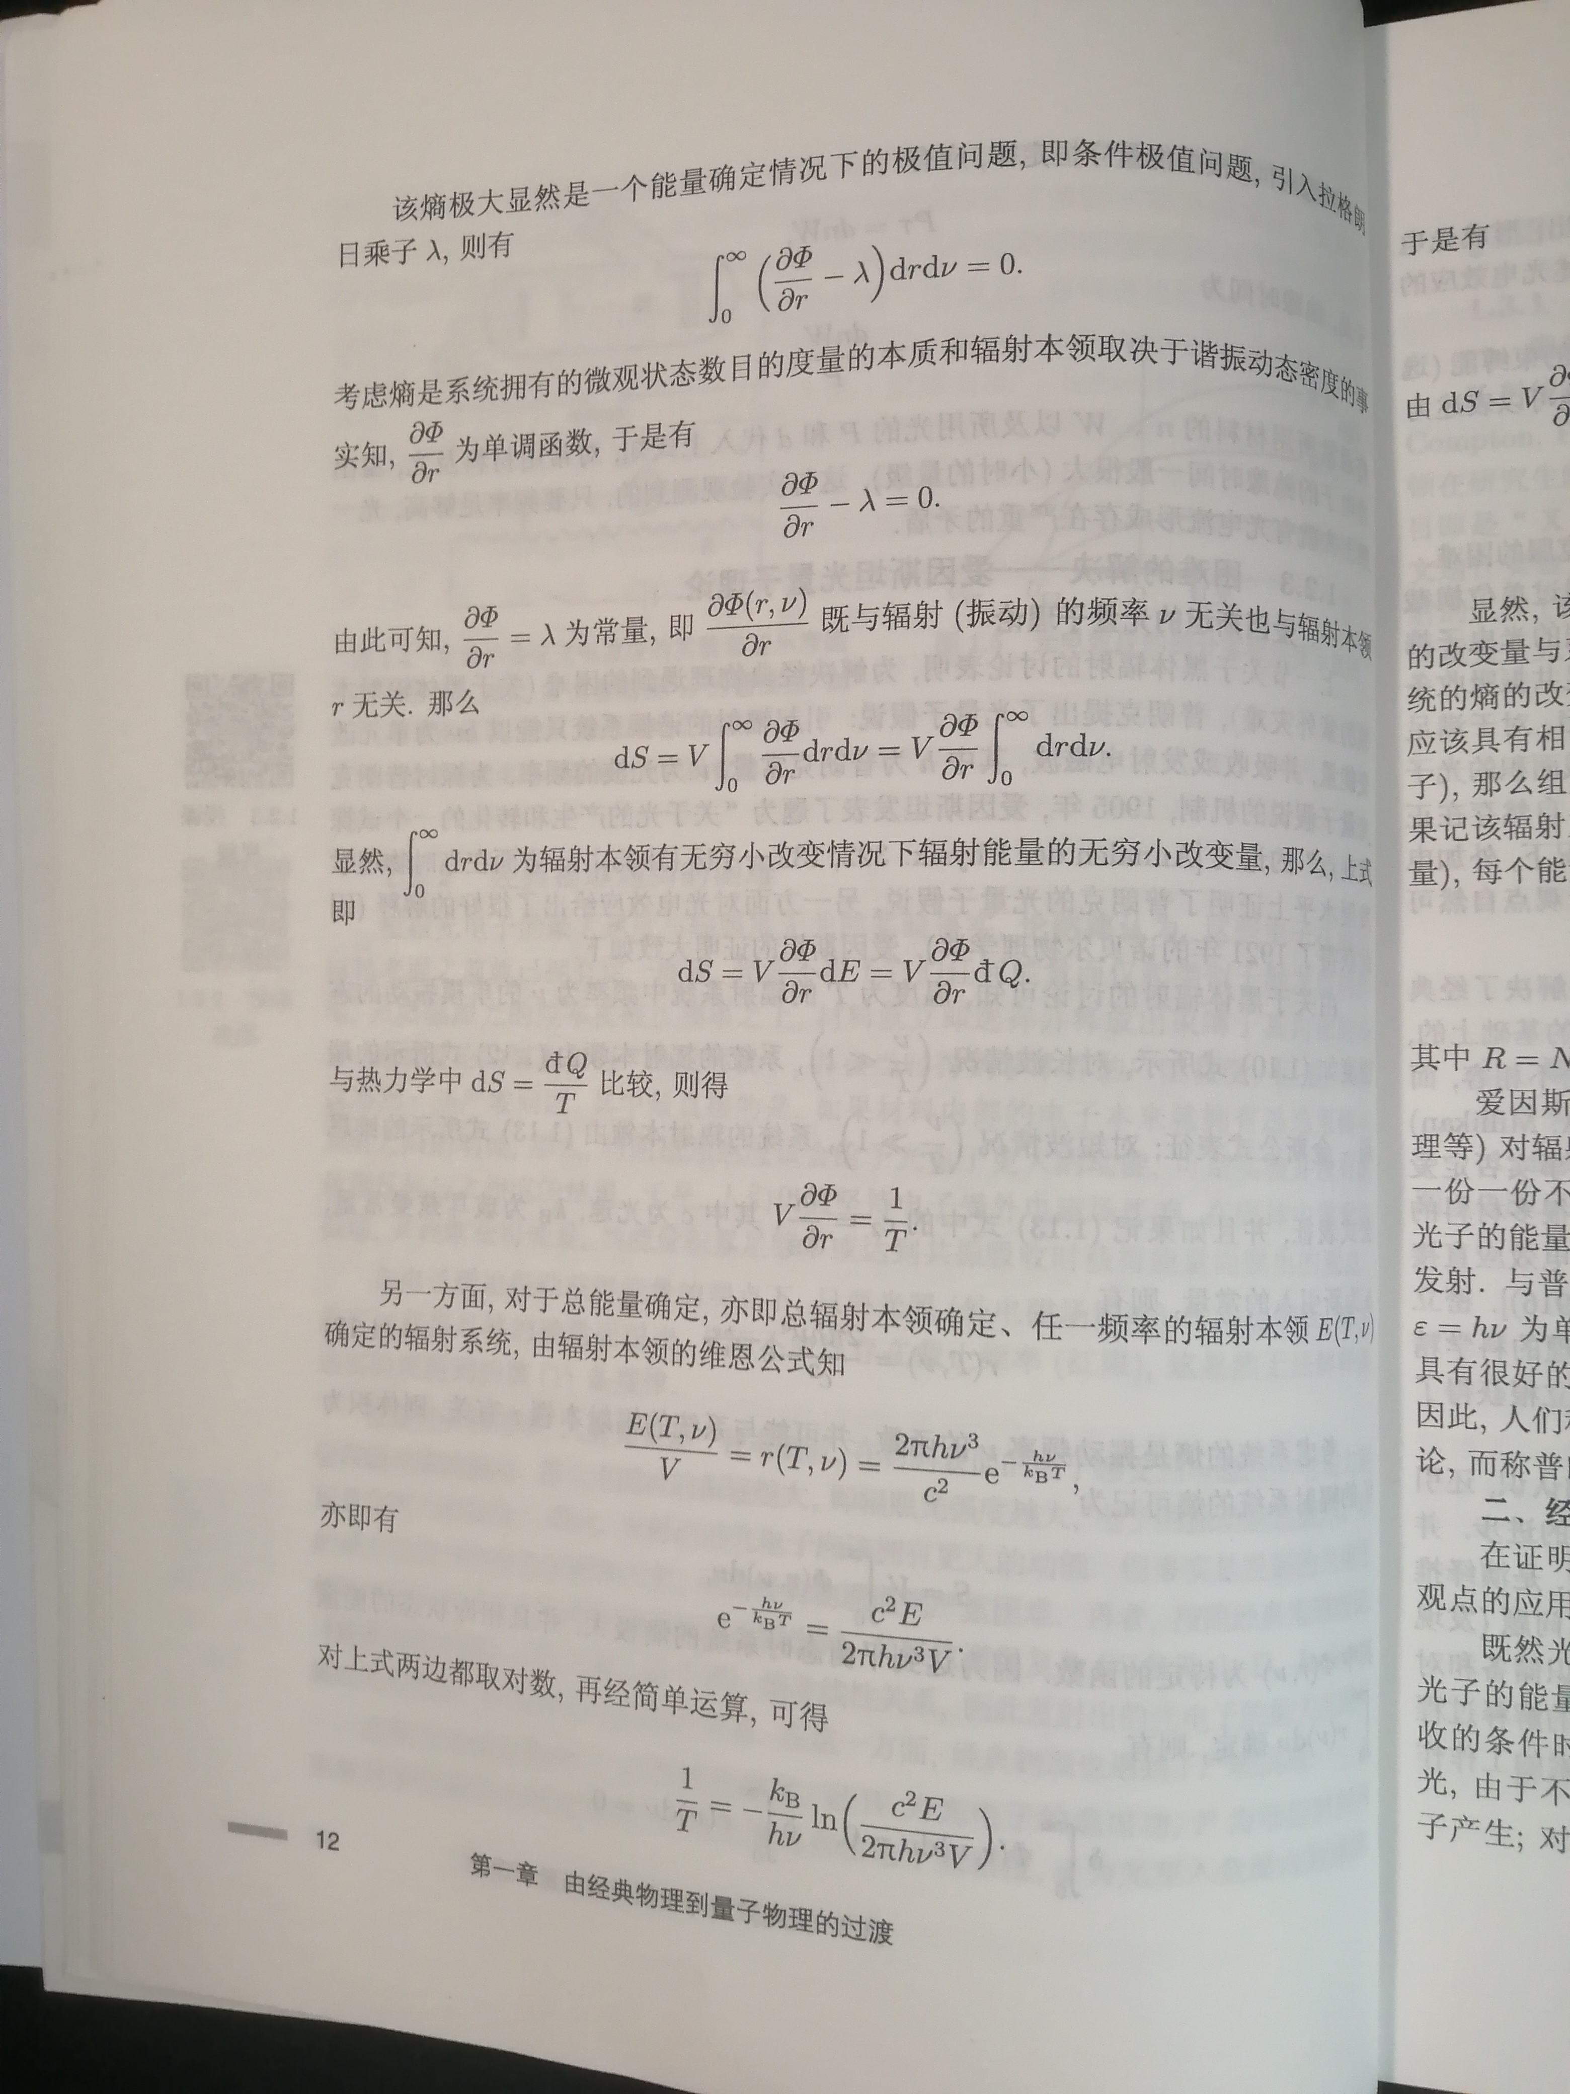
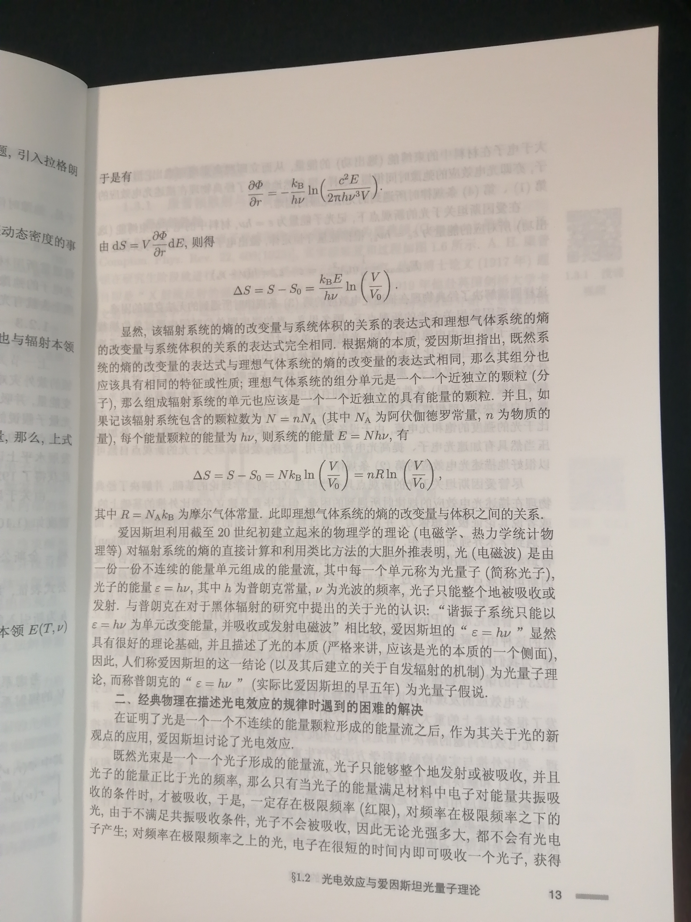
原子物理学，刘玉鑫，北京大学

Slide 14
Trying…
Total energy U
The energy density $u=\frac{U}{V}$
The rate of change of energy density with frequency as we proceed through the spectrum will be called $u_{ω}$. Hence the density of energy lying between any two given frrequencies is
$\int_{ω_{1}}^{ω_{2}}{u_{ω}dω}$
Total entropy $σ$
The entropy density $s=\frac{σ}{V}$
The rate of change of entropy density with frequency as we proceed through the spectrum will be called $σ_{ω}$. Hence the density of entropy lying between any two given frrequencies is
$\int_{ω_{1}}^{ω_{2}}{σ_{ω}dω}$
Engergy $U≡V\int_{0}^{∞}{u_{ω}dω}$
When $ℏω≫τ$, $u_{ω}=\frac{ℏ^{4}}{π^{2}{\left(ℏc\right)}^{3}}ω^{3}e^{−ℏω/τ}$
$$\frac{1}{τ}=−\frac{1}{ℏω}\log{\frac{u_{ω}}{a ω^{3}}}$$
Entropy $σ≡V\int_{0}^{∞}{σ_{ω}dω}$
$$(a=\frac{ℏ^{4}}{π^{2}{\left(ℏc\right)}^{3}},b=aω^{3}dω)$$
$$\frac{1}{τ}=\frac{∂ σ}{∂ U}\underset{⇒}{?}\frac{∂ σ_{ω}}{∂ u_{ω}}$$
$$σ_{ω}=−\frac{u_{ω}}{ℏω}(log{\frac{u_{ω}}{a ω^{3}}} −1)$$
we have:
$${dσ=Vσ}_{ω}dω=−\frac{{Vu}_{ω}dω}{ℏω}(\log{\frac{{Vu}_{ω}dω}{a ω^{3}Vdω}} −1)$$
$$=−\frac{dU}{ℏω}(log{\frac{dU}{b V} −1)}$$
$$σ\left(V\right)−σ\left(V_{0}\right)=\frac{dU}{ℏω}log \frac{V}{V_{0}}$$

Slide 15
类比方法
大胆外推
原子物理学，刘玉鑫，北京大学

Slide 16
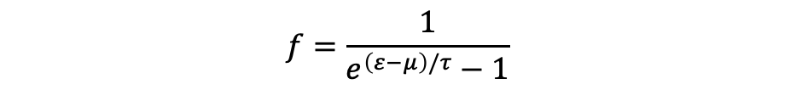
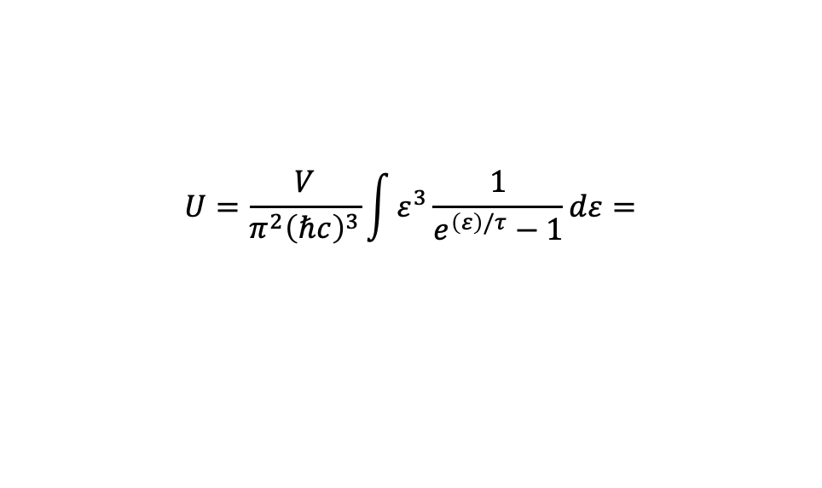
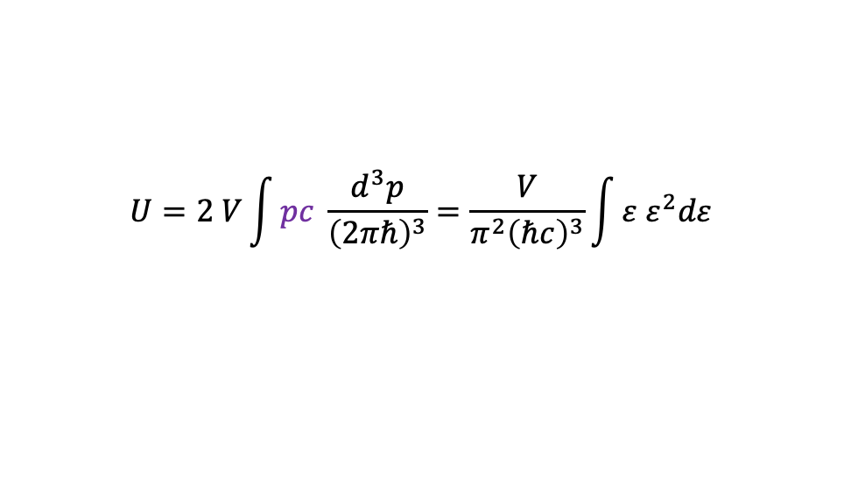
$$f=\frac{1}{e^{\left(ε−μ\right)/τ}−1}$$
BE distribution function（光子是boson）
Chemical potential is zero!!(查笔记)
$ε=pc$（色散关系）
$$U=2 V\int{pc \frac{d^{3}p}{{\left(2πℏ\right)}^{3}}=\frac{V}{π^{2}{\left(ℏc\right)}^{3}}\int{{ε ε}^{2}dε}}$$
$$U=\frac{V}{π^{2}{\left(ℏc\right)}^{3}}\int{ε^{3}\frac{1}{e^{\left(ε\right)/τ}−1}dε=}$$

Slide 17
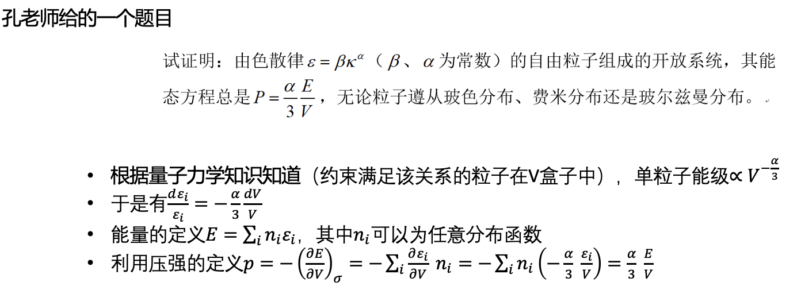

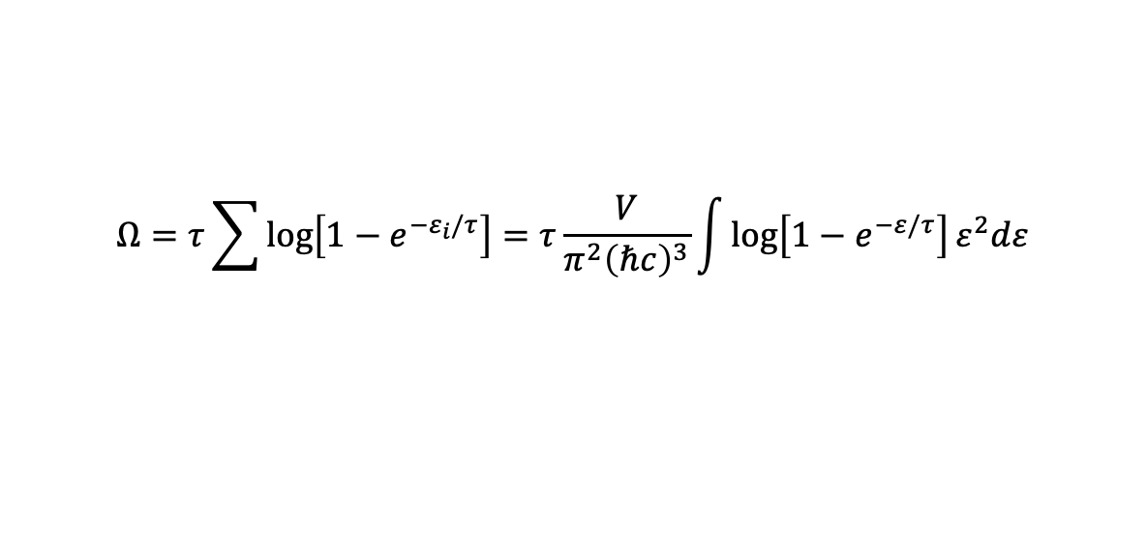
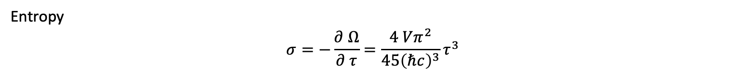
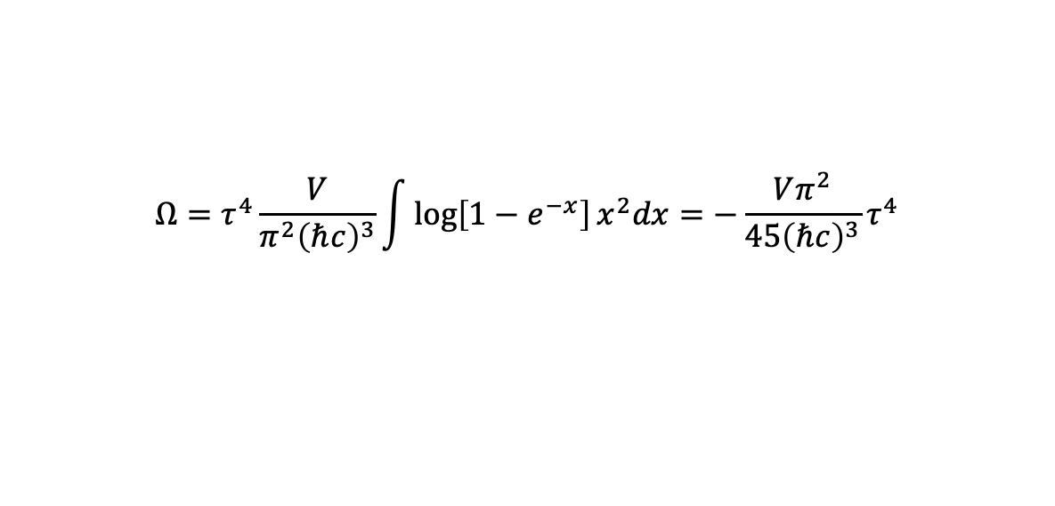
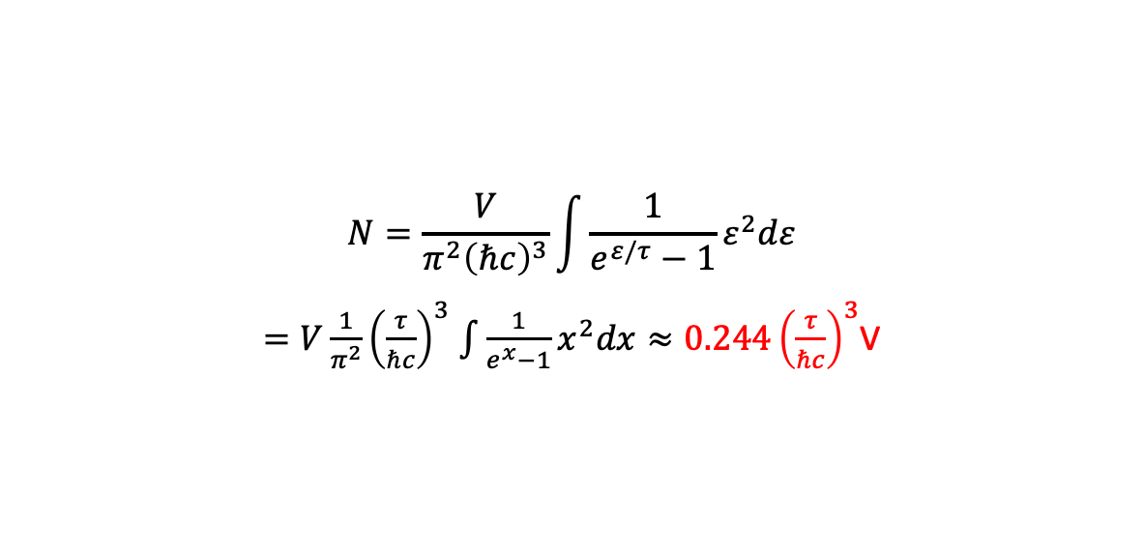
$$Ω=τ\sum{\log\left[1−e^{−ε_{i}/τ}\right]}=τ\frac{V}{π^{2}{\left(ℏc\right)}^{3}}\int{\log\left[1−e^{−ε/τ}\right]ε^{2}dε}$$
Grand potential
$$x=\frac{ε}{τ}$$
$$Ω=τ^{4}\frac{V}{π^{2}{\left(ℏc\right)}^{3}}\int{\log\left[1−e^{−x}\right]x^{2}dx}=−\frac{Vπ^{2}}{45{\left(ℏc\right)}^{3}}τ^{4}$$
Entropy
$$σ=−\frac{∂ Ω}{∂ τ}=\frac{4 Vπ^{2}}{45{\left(ℏc\right)}^{3}}τ^{3}$$
Energy(比较上一页)
$$U=Ω+στ=−\frac{Vπ^{2}}{45{\left(ℏc\right)}^{3}}τ^{4}+\frac{4Vπ^{2}}{45{\left(ℏc\right)}^{3}}τ^{4}=\frac{Vπ^{2}}{15{\left(ℏc\right)}^{3}}τ^{4}$$
Pressure
$$PV=\frac{1}{3} U$$
The total number of photons
$$N=\frac{V}{π^{2}{\left(ℏc\right)}^{3}}\int{\frac{1}{e^{ε/τ}−1}ε^{2}dε}$$
$=V\frac{1}{π^{2}}{\left(\frac{τ}{ℏc}\right)}^{3}$ $\int{\frac{1}{e^{x}−1}x^{2}dx}≈0.244{\left(\frac{τ}{ℏc}\right)}^{3}$V

Slide 18

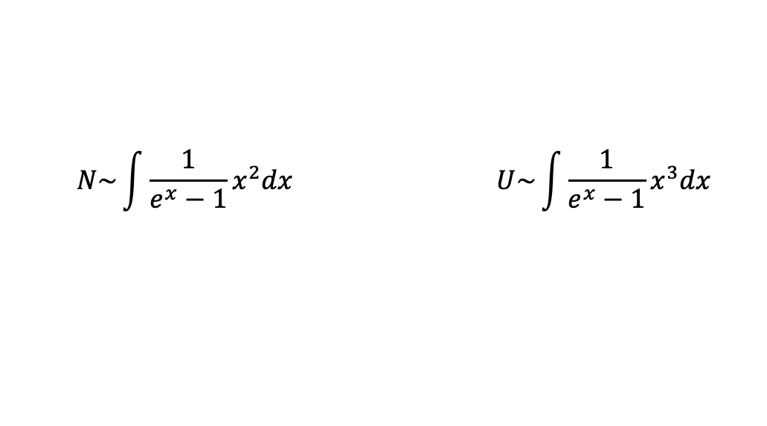
$$N\sim \int{\frac{1}{e^{x}−1}x^{2}dx} U\sim \int{\frac{1}{e^{x}−1}x^{3}dx}$$
广告：
欧拉 Γ函数和黎曼ζ函数在物理里的应用
——董校，24号上午10点

Slide 19
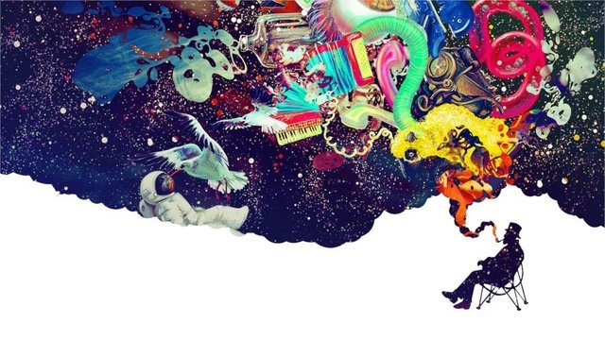
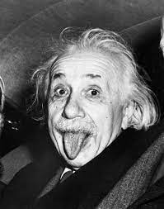
约束在腔中的辐射场相当于一大群简偕振子组成的力学体系
能量一份一份的买卖
光量子
20230417

Slide 20
黑体辐射
Debye固体
BEC

Slide 21
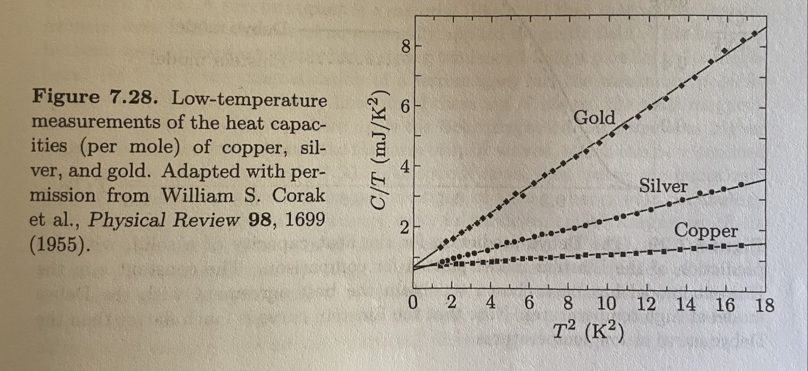
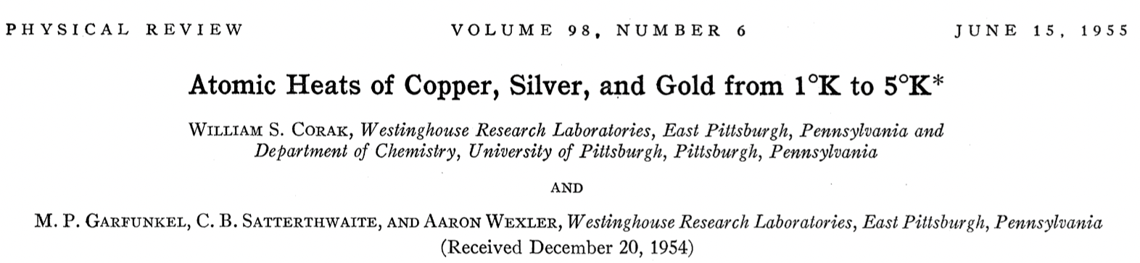

Slide 22
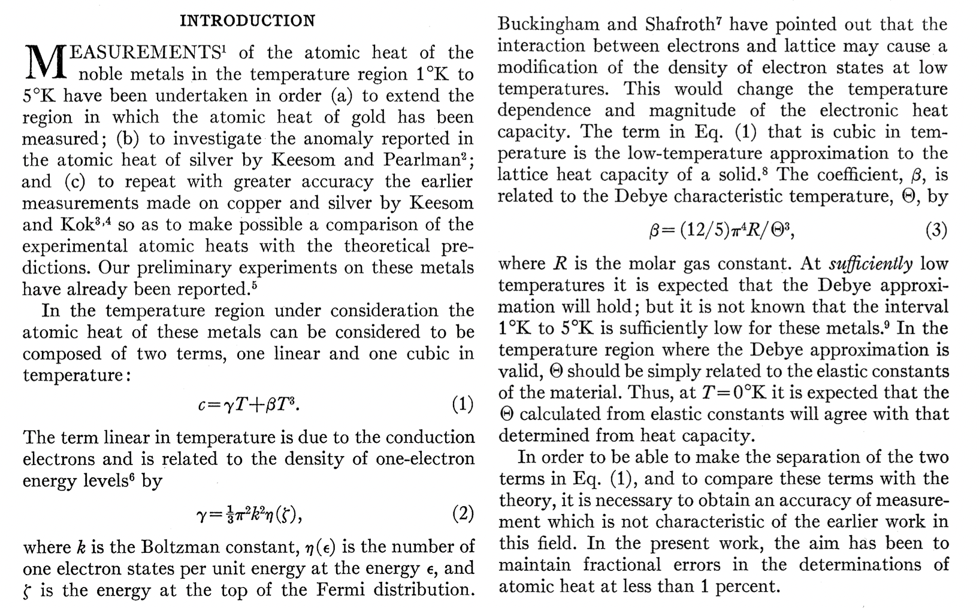

Slide 23
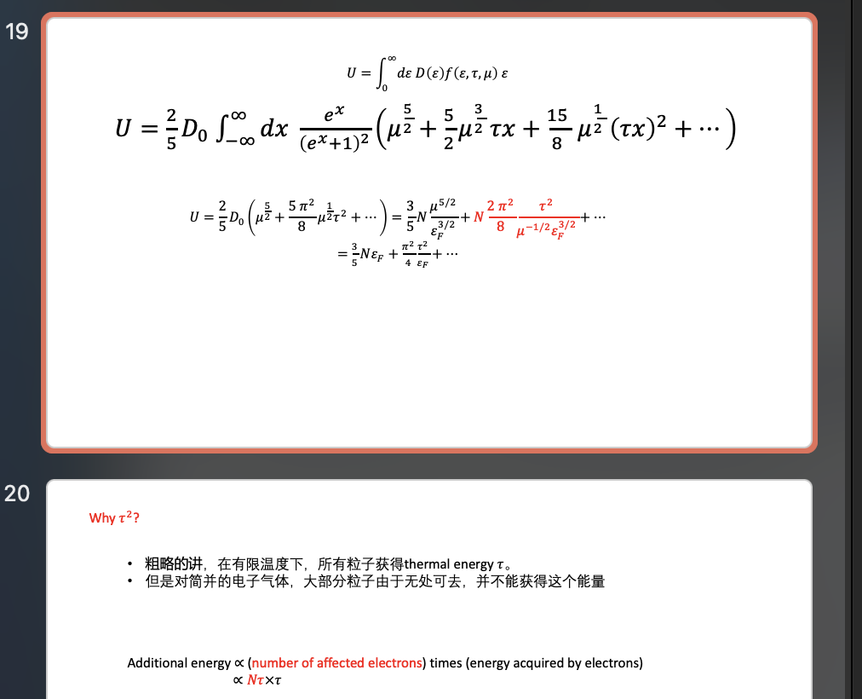

$$C=γτ+βτ^{3}$$
Part-1, electrons 查笔记

Slide 24


$$C=γτ+βτ^{3}$$
Part-2, 爱因斯坦solid 查笔记
The heat capacity goes to zero exponentially in the limit tau->0.

Slide 25


相互独立的谐振子图像!?

Slide 26


从经典图像谈起
利用牛二，某谐振子偏离平衡点的位置满足
$$k_{0}\left(u_{n+1}−u_{n}\right)−k_{0}\left(u_{n}−u_{n−1}\right)=m\frac{d^{2}u_{n}}{d^{2}t}$$
把弹簧系数、质量重新整合成本征频率，上方程可以写成
$u_{n+1}+u_{n−1}−2u_{n}=$ $\frac{1}{ω_{0}^{2}}\frac{d^{2}u_{n}}{d^{2}t}$
假设所有的谐振子具有同一个频率，上方程的解的形式可以写成$u_{n}=A_{n}e^{iωt}$，则可以给出振幅满足的方程
$$A_{n+1}+A_{n−1}=\frac{2ω_{0}^{2}−ω^{2}}{ω_{0}^{2}}A_{n}$$
为一本征方程，求解本征值和本征函数。

Slide 27



以6个为例，注意边界条件（周期性）
$\left(\begin{aligned}\begin{matrix}−\frac{2ω_{0}^{2}−ω^{2}}{ω_{0}^{2}} & 1\end{matrix} \begin{matrix}0 & 0\end{matrix} \begin{matrix}0 & 1\end{matrix} \\ \begin{matrix}1 & −\frac{2ω_{0}^{2}−ω^{2}}{ω_{0}^{2}}\end{matrix} \begin{matrix}1 & 0\end{matrix} \begin{matrix}0 & 0\end{matrix} \\ \begin{matrix}0 & 1\end{matrix} \begin{matrix}−\frac{2ω_{0}^{2}−ω^{2}}{ω_{0}^{2}} & 1\end{matrix} \begin{matrix}0 & 0\end{matrix} \\ \begin{matrix}0 & 0\end{matrix} \begin{matrix}1 & −\frac{2ω_{0}^{2}−ω^{2}}{ω_{0}^{2}}\end{matrix} \begin{matrix}1 & 0\end{matrix} \\ \begin{matrix}0 & 0\end{matrix} \begin{matrix}0 & 1\end{matrix} \begin{matrix}−\frac{2ω_{0}^{2}−ω^{2}}{ω_{0}^{2}} & 1\end{matrix} \\ \begin{matrix}1 & 0\end{matrix} \begin{matrix}0 & 0\end{matrix} \begin{matrix}1 & −\frac{2ω_{0}^{2}−ω^{2}}{ω_{0}^{2}}\end{matrix}\end{aligned}\right)\left(\begin{aligned}A_{1} \\ A_{2} \\ A_{3} \\ A_{4} \\ A_{5} \\ A_{6}\end{aligned}\right)=0$
$$A_{N}=A_{−1}$$
$${A_{N+1}=A}_{1}$$

Slide 28



$$\left(\begin{aligned}A_{1} \\ A_{2} \\ A_{3} \\ A_{4} \\ A_{5} \\ A_{6} \\ . \\ . \\ . \\ A_{N}\end{aligned}\right)=\left(\begin{aligned}e^{iφ} \\ e^{i2φ} \\ e^{i3φ} \\ e^{i4φ} \\ e^{i5φ} \\ e^{i6φ} \\ . \\ . \\ . \\ e^{iNφ}\end{aligned}\right)$$
$$ω_{0}^{2}\left(e^{i(n+1)φ}+e^{i(n−1)φ}\right)=\left(2ω_{0}^{2}−ω^{2}\right)e^{inφ}$$
$$⟹ω^{2}=2ω_{0}^{2}\left(1−cosφ\right)⟹{\left(ω_{0}sin\frac{φ}{2}\right)}^{2}$$
$$e^{i(N+1)φ}=e^{iφ}⟹e^{iNφ}=1$$
$$⟹φ_{n}=\frac{2nπ}{N}=0,±\frac{2π}{N},±\frac{4π}{N},…,±π=0,±\frac{2π}{N},±\frac{4π}{N},…,π, noted e^{inπ}=e^{−inπ}$$
共有N个mode！
$$ω_{n}=ω_{0}\left|sin\frac{φ_{n}}{2}\right|=ω_{0}\left|sin\frac{k_{n}a}{2}\right|$$
色散关系！！！(between the angular frequency and the wavenumber)
In the continuum limit, $a→0, N→∞$, with Na held fixed, $u_{n}→φ(x)$, a scalar field, and $ω∝ka$

Slide 29



The maximum mode number n
$$n_{max}=\sqrt[3]{N}$$

Slide 30




量子图像

Slide 31
声子 Phonon

Slide 32










Phonons in a box
Consider a cube of side L, the wavelengths
$$k_{n}=\frac{2π}{L}(n_{x},n_{y},n_{z})$$
Dispersion relation $ω=c_{s}|k|$
The energy of phonon is
$$ε_{n}=ℏω\left(k_{n}\right)=ℏc_{s}k_{n}$$
$$\sum_{n}{}→\sum_{k}{}\underset{→}{V→∞}\frac{L^{3}}{{(2π)}^{3}}\int{d^{3}k}$$
$$U=3\frac{L^{3}}{{(2π)}^{3}}\int{d^{3}k} \frac{ℏω(k)}{e^{ℏω(k)/τ}−1}$$
$$U=\int{dω} \frac{ℏω}{e^{\frac{ℏω}{τ}}−1}g(ω)$$
$$g\left(ω\right)=3\frac{L^{3}}{{(2π)}^{3}}\frac{4πω^{2}}{c_{s}^{3}}$$
$$ω_{D}=c_{s}{\left(\frac{6π^{2}N}{V}\right)}^{\frac{1}{3}}$$
$$3N=\int_{0}^{ω_{D}}{g\left(ω\right)dω}$$
Debye temperature:
$$τ_{D}=ℏω_{D}$$
$$U=\int_{0}^{ω_{D}}{dω}\frac{ℏω}{e^{\frac{ℏω}{τ}}−1}g(ω)$$

Slide 33



$$U=9Nτ{\left(\frac{τ}{τ_{D}}\right)}^{3}\int_{0}^{{τ_{D}}/τ}{\frac{x^{3}}{e^{x}−1}dx}$$
$τ≫τ_{D}$, $\int_{0}^{τ_{D}/τ→0}{\left(…\right)|_{e^{x}≈1+x}→U=3Nτ}$
$τ≪τ_{D},$ $\int_{0}^{∞}{\left(…\right)→U=\frac{3π^{4}}{5}\frac{Nτ^{4}}{τ_{D}^{3}}}$
At temprature $τ$, only phonon modes with an energy betlow the thermal energy $τ$ become thermally excited. These modes have $ℏω(k)≤τ$.
By substituting the dispersion relation intro the above inequality, we conclude that these modes have wave vectors $|k|≤\frac{τ}{ℏc_{s}}$, mutiplied by the density of modes in k-space, ${\left(\frac{L}{2π}\right)}^{3}.$ Thus the total numer of excited modes is $N_{modes}=\frac{4}{3}π{|k|}^{3}$ ${\left(\frac{L}{2π}\right)}^{3}\sim {\left(\frac{τL}{ℏc_{s}}\right)}^{3}$.
The total thermal energy $N_{modes}τ∝τ^{4}$.

Slide 34


Debye versus Einstein
20230419

Slide 35
黑体辐射
Debye固体
BEC
Condensate=凝聚

Slide 36


我第一次接触所谓的“凝聚”
两个费米子可以结合成玻色子
形成凝聚，作为一个序参量，该凝聚表征手征对称性破缺
在手征极限下可以严格定义，如何“定义”超越手征极限下的凝聚，一直是一个问题
希望你们能够从今天开始能记住凝聚这个概念
课程后面讲相变的时候，我们会重温凝聚这个概念
Condensate=凝聚

Slide 37

黑体辐射
Debye固体
BEC
广东工业大学的庞玮老师

Slide 38


Ordinary Bosons
BEC is a quantum phenomenon in Bose gases in which a large number of bosons simultaneously occupy the ground state of a system.
BEC state was first predicted, generally, in 1924-1925 by A. Einstein following and crediting a pioneering papery by Bose on the new filed now known as quantum statistics.
On 5 June 1995, the first gaseous condensate was produced.

Slide 39
简单？

Slide 40



Two-state system(canonical ensemble)
$$ε_{0}=ε$$
$$ε_{0}=0$$
One particle
Partition Function $Z_{1}=1+e^{−ε/τ}$
The fraction of particles in the ground state(hold for any statistics)
$$\frac{\left\langle N_{ground}\right\rangle }{N}=\frac{1}{Z_{1}}=\frac{1}{1+e^{−ε/τ}}$$

Slide 41





N个全同粒子
Boltzmann
Bose-Einstein
Partition Function
$$Z_{N}^{B}=\frac{1}{N!}{\left(Z_{1}\right)}^{N}=\frac{1}{N!}{\left(1+e^{−ε/τ}\right)}^{N}$$
The fraction of particles in the ground state
$$\frac{\left\langle N_{ground}\right\rangle }{N}=\frac{1}{1+e^{−ε/τ}}$$
At large temperature half the particles are in the gound states, half in the excited state.
Partition Function
$$Z_{N}^{BE}=1+e^{−ε/τ}+…+e^{−\frac{Nε}{τ}}=\frac{1−e^{−(N+1)ε/τ}}{1−e^{−ε/τ}}$$
The fraction of particles in the ground state
$$\frac{\left\langle N_{ground}\right\rangle }{N}=\frac{1}{N}\frac{1}{Z_{N}^{BE}}\left[N.1+\left(N−1\right).e^{−ε/τ}+…0.e^{−\frac{Nε}{τ}}\right]=\frac{1}{N}\left(\frac{1}{e^{−ε/τ}−1}+\frac{N+1}{1−e^{−(N+1)ε/τ}}\right)$$
$$\frac{\left\langle N_{ground}\right\rangle }{N=100}$$
Bose-Einstein
Boltzmann
$$τ/ε$$

Slide 42







$$\frac{\left\langle N_{ground}\right\rangle }{N=100}$$
高温极限下，两种统计都给出平均分布特点；
对于不考虑量子特征的B统计，只有在温度极度低的时候，基态才会体现出可观的布局数
但是对于考虑量子特征的BE统计，基态布局数即使在温度高于$ε$时，也是可观的，比如$\frac{τ}{ε}=\frac{N}{10}处，我们发现其基态占据份额为90\%$
Bose-Einstein
Boltzmann
$$τ/ε$$
$$\frac{1}{N}\left(\frac{1}{e^{−ε/τ}−1}+\frac{N+1}{1−e^{−(N+1)ε/τ}}\right)$$
$$\frac{1}{2}+\frac{Nε}{12τ}$$
$$1−\frac{τ}{Nε}$$

Slide 43



让我们从玻色爱因斯坦分布出发，计算基态（定义为零）布局数
$$\left\langle n_{i}\right\rangle =\frac{1}{e^{\left(ε_{i}−μ\right)/τ}−1}$$
由此可得基态布局数只是依赖于化学势和温度(注意bose气体的化学势小于任何能级，即$μ<0 when ε_{0}=0$)
$$\left\langle N_{ground}\right\rangle =\frac{1}{e^{−μ/τ}−1}$$
从而可以把化学势用N_{ground}来表达，$e^{−μ/τ}=\frac{1}{\left\langle N_{ground}\right\rangle }+1$
系统总粒子数可以表示为
$$N=\sum_{i}{\frac{1}{e^{\left(ε_{i}−μ\right)/τ}−1}=\sum_{i}{\frac{1}{e^{ε_{i}/τ}\left(\frac{1}{\left\langle N_{ground}\right\rangle }+1\right)−1}}}$$
只要能搞定求和，根据上方程可以得到$\left\langle N_{ground}\right\rangle /N$!!!

Slide 44


考虑约束在边长为L的方盒子中的玻色子，由于我们关心的是低温情形，故玻色子是非相对论性的。单粒子能级为
$$ε_{n}=\frac{ℏ^{2}π^{2}}{2mL^{2}}{\vec{n}}^{2}$$
我们移基态能量为零，且不考虑自能，第一激发态能量$ε_{1}=\frac{ℏ^{2}π^{2}}{2mL^{2}}$，所有其他能级能量可以表示成
$$ε_{n}=ε_{1}n^{2}$$
$$N=\sum_{n_{x},n_{y},n_{z}=0}^{∞}{\frac{1}{e^{\left(n_{x}^{2}+n_{y}^{2}+n_{z}^{2}\right)ε_{1}/τ}\left(\frac{1}{\left\langle N_{ground}\right\rangle }+1\right)−1}}$$

Slide 45


数值计算

Slide 46



解析（近似）
$\sum_{n}{→}\frac{1}{8}\int_{0}^{∞}{4πn^{2}dn}$ $dε=2ε_{1} n dn$
$$\sum_{n}{→}\frac{1}{8}\int_{0}^{∞}{4πn^{2}dn}=\frac{π}{2} \int_{0}^{∞}{n n dn=}\frac{π}{2} \int_{0}^{∞}{\sqrt{\frac{ε}{ε_{1}}} \frac{dε}{2ε_{1}}=\frac{π}{4ε_{1}^{3/2}} \int_{0}^{∞}{\sqrt{ε}dε}}=\int_{0}^{∞}{g\left(ε\right)dε}$$
$$N=\frac{π}{4ε_{1}^{3/2}} \int_{0}^{∞}{\sqrt{ε} \frac{1}{e^{(ε−μ)/τ}−1}dε}$$

Slide 47



$$N=\frac{π}{4ε_{1}^{3/2}} \int_{0}^{∞}{\sqrt{ε} \frac{1}{e^{(ε−μ)/τ}−1}dε}$$
注意化学势（记住是温度依赖地）
假设化学势为零
$$N=ζ_{3/2} n_{Q} V≈2.612n_{Q} V$$
注意，方程左边N与温度无关，方程右边出现量子浓度，与温度有关，不可能成立；但可以想象该关系在特定的温度下是成立的，引入由此式所确定的温度$τ_{c}，即$
$$μ\left(τ_{c}\right)=0$$
看其他的温度区域
当温度大于 $τ_{c}$，要使化学势小于零，可以压低右边的积分值，使方程满足，即
该区域的化学势小于零
那么温度小于 $τ_{c}$的区域呢？你不可能使化学势大于零，左边那根曲线已经对应最多的粒子数了，不够啊

Slide 48





$$N=\frac{π}{4ε_{1}^{3/2}} \int_{0}^{∞}{\sqrt{ε} \frac{1}{e^{(ε−μ)/τ}−1}dε}$$
$$ε→0$$
$$\frac{1}{\sqrt{ε}}$$
当 $ε$趋于零的时候，几分核根号发散，好消息，积分收敛，没问题
那我们在离散求和变积分的时候，是否做了严格表示呢？
回答当然是否定的，因为我们知道粒子数可以任意的多！
那么上面这个积分表示的是什么意思？
$$\int_{0}^{∞}{}≈\int_{δ}^{∞}{}$$
除了基态外所有激发态粒子的数目
基态粒子数 $N_{ground}=N−N_{excited}=\left(1−{\frac{τ}{τ_{c}}}^{3/2}\right)N$
当温度小于临界温度时，化学势为零
$$N_{excited}≈2.612n_{Q} V={\left(\frac{τ}{τ_{c}}\right)}^{3/2}N$$

Slide 49


Slide 50

从理论预言，到实验发现，走了70年
$$τ_{c}=\frac{4ε_{1}}{π}{\left(\frac{N}{ζ_{3/2}}\right)}^{2/3}=3.31\frac{ℏ^{2}}{m}{\left(\frac{N}{V}\right)}^{2/3}$$
从临界温度看，更多的粒子、更小的体积、更轻的质量，都可以使临界温度变高。
Cornell and Weimann, and Ketterle, used Rubidium atoms, 铷原子，序号87
利用激光冷却技术，实现低温，发现相变温度为170nK，和上公式吻合的很好
In order to see the BEC, one needs to be able to distinguish atoms in the ground state from atoms in the excited states. The basic feature that makes this possible is that the ground state atoms all have smaller wavenumbers and hence slower velocities than the other states. So if you remove the magnetic trap, the atoms will start to spread, with the ground state atoms spreading more slowly. Thus the atoms' positions after a short time indicate their initial velocities.

Slide 51

In this fgure, from Weimann and Cornell's group at the JILA laboratory in Boulder, we see the distribution of atoms in the BEC at dierent temperatures. The critical temperature is Tc 170nK. Above this temperature (left), the distribution is pretty smooth, consistent with a Maxwell-Boltzmann velocity distribution. Below the critical temperature you can clearly see the higher density corresponding at an anomalously large occupancy of the ground state, consistent with expectations from a BEC. The right image shows the BEC at even lower temperature, where the occupancy is even higher. Direct observation of thermodynamic properties of the system, such as the energy density and heat capacity (particularly by Ketterle's group at MIT), further conrmed that this system was a BEC.

Slide 52
总结
2022.05.03

Slide 53




第一页补充
$∇^{2}A−\frac{1}{c^{2}}\frac{∂ A}{∂ t}=0$
考虑某个方向的A，比如Ax，一般解可以写成
$$φ=f\left(t\right)X(x)Y(y)Z(z)$$
满足方程
$$\frac{1}{X}\frac{∂^{2}X}{∂x^{2}}+\frac{1}{Y}\frac{∂^{2}Y}{∂y^{2}}+\frac{1}{Z}\frac{∂^{2}Z}{∂z^{2}}−\frac{1}{c^{2}f}\frac{∂^{2}f}{∂t^{2}}=0$$
$X=A\cos\left[px\right]+A^{′}\sin\left[px\right]$
$Y=B\cos\left[qy\right]+B^{′}\sin\left[qy\right]$
$Z=C\cos\left[rz\right]+C^{′}\sin\left[rz\right]$
$$p^{2}+q^{2}+r^{2}=\frac{ω^{2}}{c^{2}}$$
边界条件、规范
$A_{x}=\sum_{lmn}{Af\left(t\right)cos\frac{lπx}{L}sin\frac{mπy}{L}sin\frac{nπz}{L}}$
$A_{y}=\sum_{lmn}{Bf\left(t\right)sin\frac{lπx}{L}cos\frac{mπy}{L}sin\frac{nπz}{L}}$
$A_{z}=\sum_{lmn}{Cf\left(t\right)sin\frac{lπx}{L}cos\frac{mπy}{L}cos\frac{nπz}{L}}$
$$z$$
$$y$$
$$x$$

Slide 54




$$U=\sum_{n_{x}}^{\sqrt[3]{N}}{\sum_{n_{y}}^{\sqrt[3]{N}}{\sum_{n_{z}}^{\sqrt[3]{N}}{ε \overline{N}(ε)}}}$$
计算一下能量
近似：高温、低温、不高不低温
$$U≈\int_{0}^{\sqrt[3]{N}}{\int_{0}^{\sqrt[3]{N}}{\int_{0}^{\sqrt[3]{N}}{ε \frac{3}{e^{ε/τ}−1}}dn_{x}dn_{y}dn_{z}}}$$
球坐标，粒子数conserving in the cube and in the eighth of a sphere…$N=\frac{1}{8}\frac{4}{3}πR^{3}$
$$U≈\int_{0}^{π/2}{\int_{0}^{π/2}{\int_{0}^{R}{ε \frac{3}{e^{ε/τ}−1}}n^{2}sinθdndθdφ}}$$

